Slide 1
Data Science Summer 2018 Internship Cases
Gustavo Oliveira – Syracuse University – ISCHOOL
APPLIED DATA SCIENCE – MASTERS PROGRAM
Contact: goliveir@syr.edu - 302-727-1599
Confidential

Slide 2
Industry
One of the three largest container shipping companies in the world.
LATAM regional office
Large amount of non-integrated data
Large amount of exploratory analysis needed (not enough time to explore)
For all the projects, data needed to be cleaned and contextualized
Confidential

Slide 3
Projects for the Internship
7 week internship projects:
Define a Tier Segmentation for clients.
Be able to price with more precision and speed
Have a hierarchical understanding and uniformity of pricing throughout the company
Develop Volume and Revenue Forecast Models for 1-2-3 weeks ahead
Today all reporting is explanatory and actions are reactive.
Idea is to be able to act in advance and maintain a high volume shipping rate.
Guidelines of what was expected as results was provided. Tools and methods were suggested and developed by intern.
Intern was also requested to provide recommendations to improve global data manipulation and integration throughout the office.
Confidential

Slide 4
TIER SEGMENTATION
Solution Proposed:
Use Cluster Analysis to define the segments and assist the Trade Directors to create the Tiers.
Proposition was very well accepted.
Method used:
K-means cluster analysis with Gower’s Distance
K-means – you pre define the number of clusters for the model by the K parameter.
In this case, we calculated from k=2 to k=15/20/40/100 and used the Silhouette Index to identify the optimal number of clusters.
Confidential

Slide 5
TIER SEGMENTATION
Method used:
After significant amount of data analysis and specialist input we decided to use 3 variables for the cluster analysis. Two Categorical and one numerical variable, hence the use of Gowers Distance, which accounts for mixed type of variables.
With specialist input and many trials later it was decided to use weights on variables to give more strength to variables that experienced showed were more relevant to the business.
Once the clusters were created, specialists reviewed for validation.
The clusters were all used for Client Tier segmentation definition.
Confidential

Slide 6
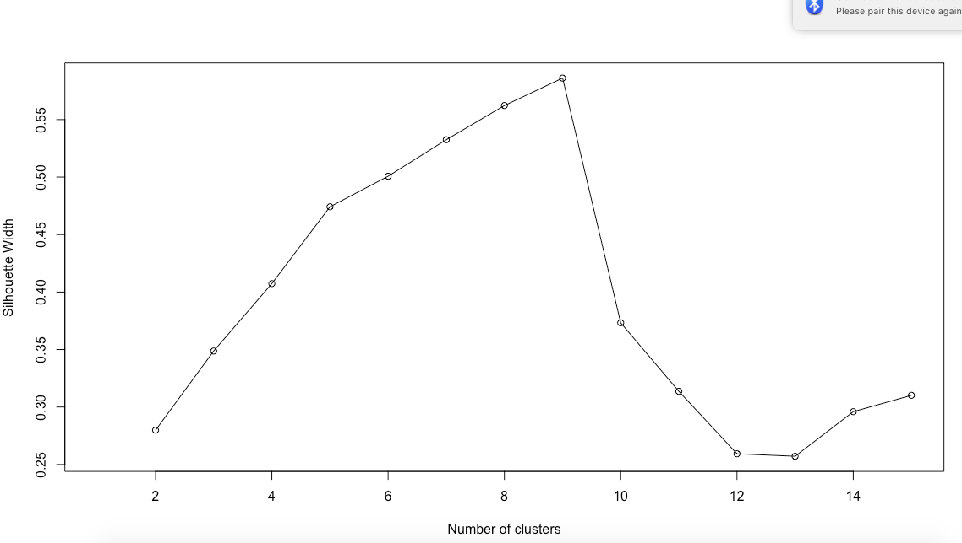
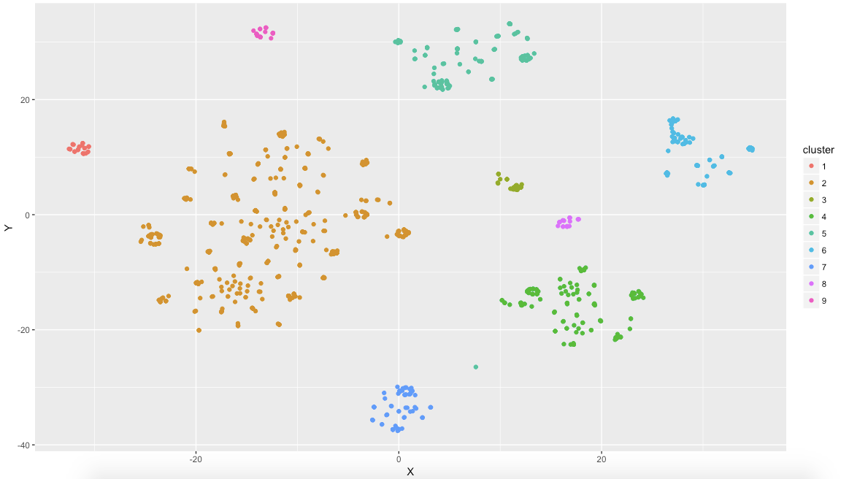
Some Results: Trade 1
Silhouette for best number of Clusters
Clusters
Confidential

Slide 7
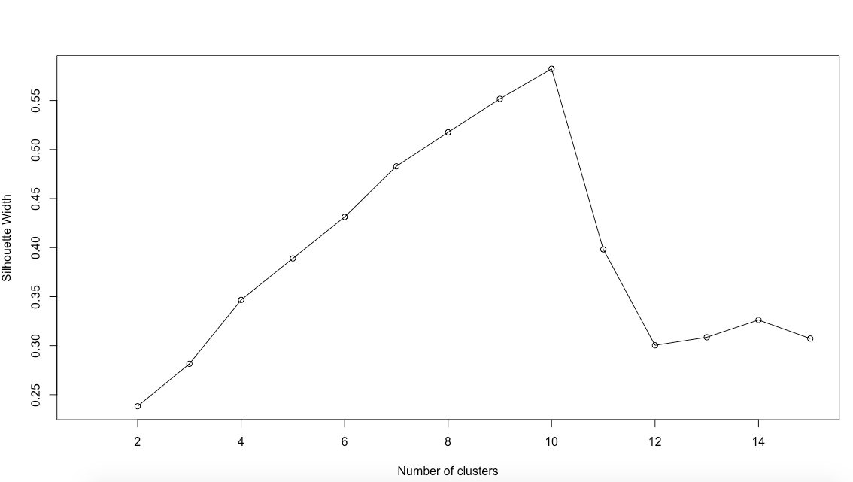
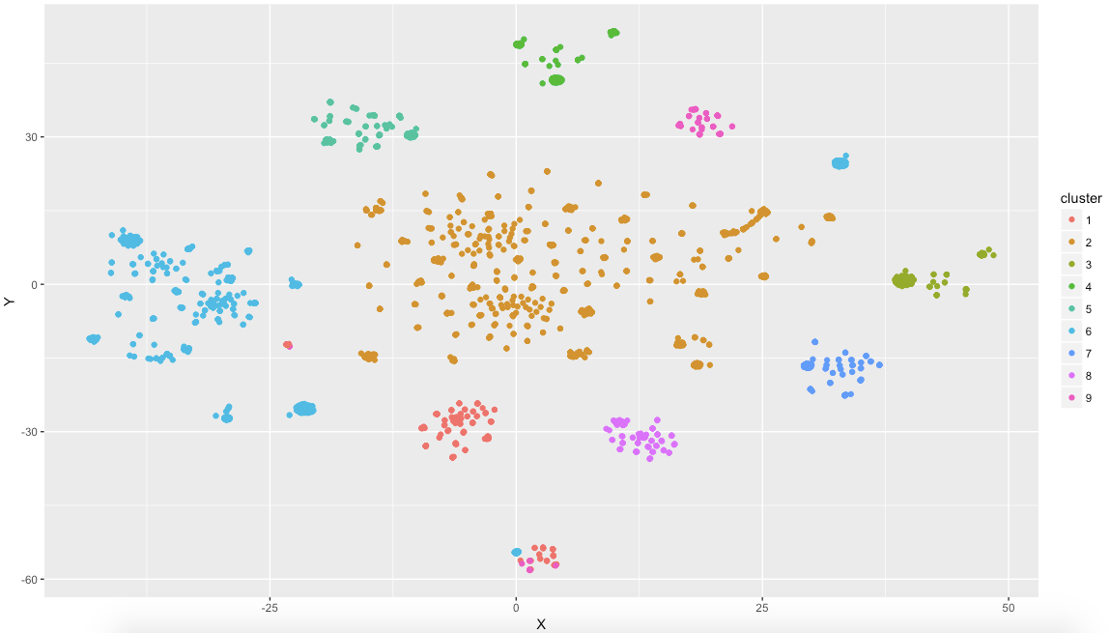
Some Results: Trade 2
Silhouette for best number of Clusters
Clusters
Confidential

Slide 8
Volume and Revenue Forecast
Data:
Forecast Volume and revenue per shipping voyage:
Revenue data not available in the breakdown needed immediately
Volume Data needed a lot of pre-processing to run the models.
Volume model can be extrapolated to forecast revenue.
More than 1000 voyages, so efforts were concentrated on the most relevant for the Regional Office:
Modelling is an ongoing activity, so guidelines were defined for model definition so the work could be continued once the internship was over.
Confidential

Slide 9
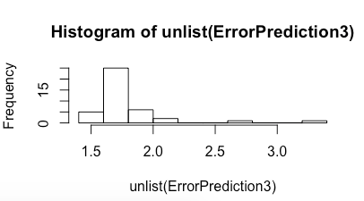
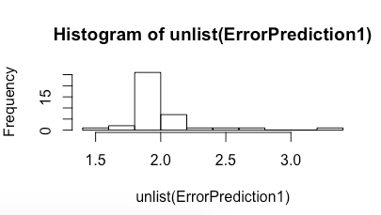
Volume and Revenue Forecast
Models Used:
After attempts with different models, RNN (Recurrent Neural Network), specifically Long Short-Term Model (LSTM) worked the best.
For cross validation and result confidence interval we used Monte Carlo Simulation on top of the neural net.
Error Analysis (% of error per simulation):
Confidential

Slide 10
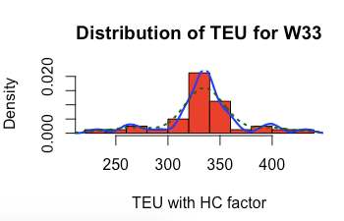
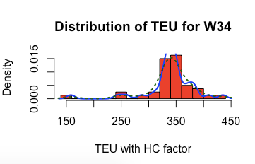
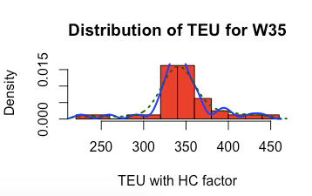
Volume Results
With a distribution/density graph you have a range and probability of forecast:
Week 33
Week 34
Week 35
Confidential

Slide 11
Summary
Techniques used:
Cluster Analysis
K-means, Gower Distance
Recurring Neural Networks
Long Short-Term Model
Monte Carlo Simulation
Confidence interval
Tools used
Excel VBA
RStudio
Provided recommendations to improve overall data management, such as:
Pull data management from the IT department and create an independent Data Management and Analytics department (Responding directly to the SVP/CEO)
Guarantee data integrity across the company (all areas should be using the same correct data)
Integrate and develop automated tools for efficient data manipulation.
Confidential

Slide 12
Intern Contact Info
Gustavo Oliveira – Syracuse University – iSchool
APPLIED DATA SCIENCE – MASTERS PROGRAM
Contact info: goliveir@syr.edu - 302-727-1599
Confidential

